Slide 1
Numerical methods of a single Ordinary differential equation (Ode) for Integration
Vistas in advanced computing (VAC) 2017, Review sessions
Joel Chavali

Slide 2
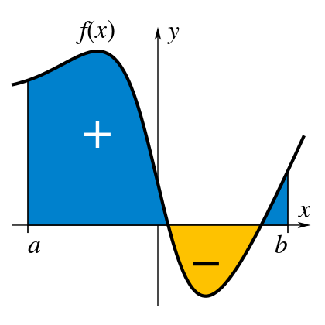
The Basics
Integration is… Area under a curve
Normal Integration with bounds. Gives an exact answer.
Numerical Integration finds the area using different shapes and predictions of values when necessary.
How we used Numerical Integration:
Calculate the integrated function from a differential equation.
(Solved for u^{n+1})
dt matters!

Slide 3
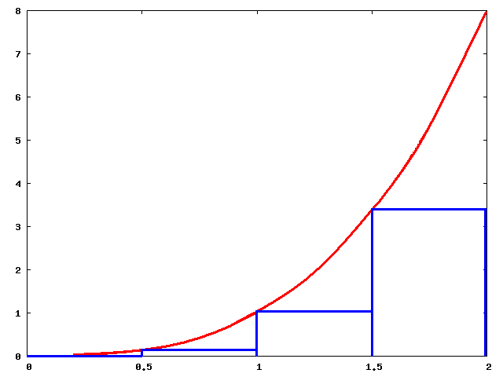

Left side
Error: O(dt)
GENERAL INTEGRAL FORM: u^{n+1} = u^{n} + $\int_{tn}^{tn+1}{f\left( t, u\left(t\right) \right) dt}$
u^{n+1} = u^{n} + dt x f*
Left: u^{n+1} = u^{n} + dt x f(t^{n}, u^{n})

Slide 4
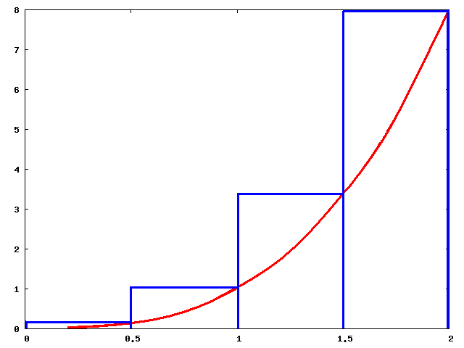
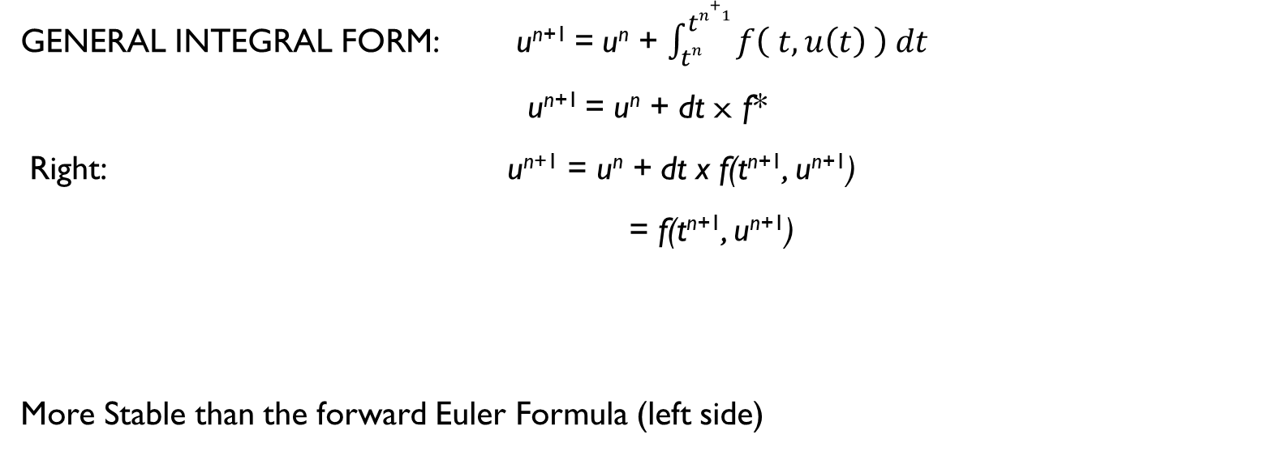
Right Side
Error: O(dt)
GENERAL INTEGRAL FORM: u^{n+1} = u^{n} + $\int_{tn}^{tn+1}{f\left( t, u\left(t\right) \right) dt}$
u^{n+1} = u^{n} + dt x f*
Right: u^{n+1} = u^{n} + dt x f(t^{n+1}, u^{n+1})
= f(t^{n+1}, u^{n+1})
More Stable than the forward Euler Formula (left side)
u^{n+1} – u^{n}
________
dt
Derivative

Slide 5
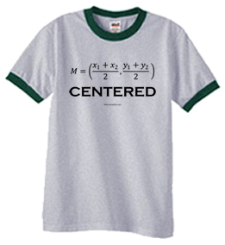
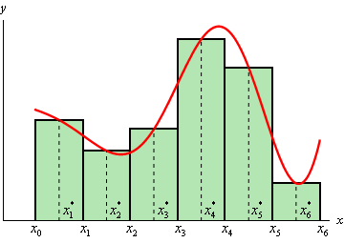
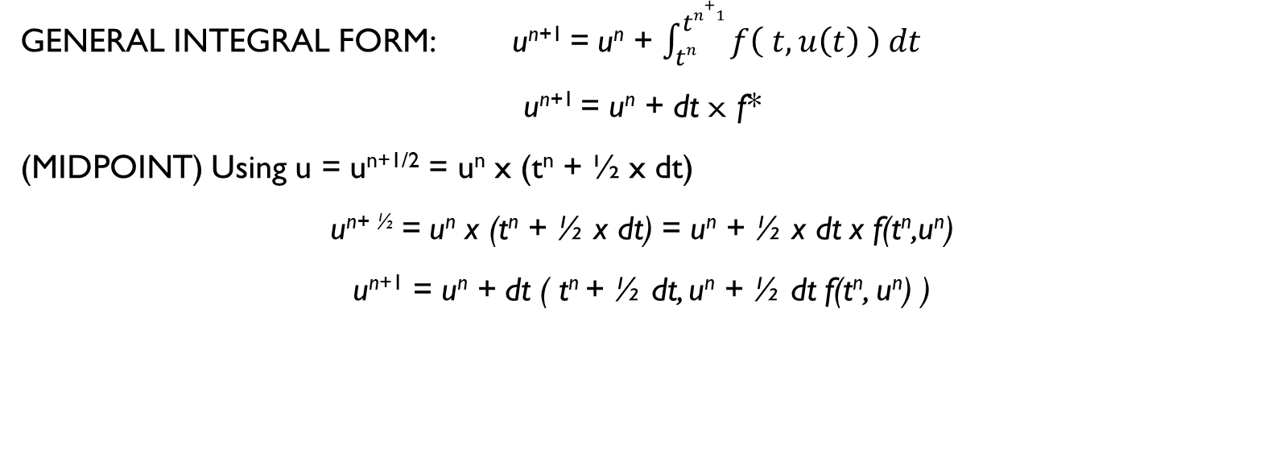
Midpoint
Error: O(dt)
GENERAL INTEGRAL FORM: u^{n+1} = u^{n} + $\int_{tn}^{tn+1}{f\left( t, u\left(t\right) \right) dt}$
u^{n+1} = u^{n} + dt x f*
(MIDPOINT) Using u = u^{n+1/2} = u^{n} x (t^{n} + ½ x dt)
u^{n+ ½} = u^{n} x (t^{n} + ½ x dt) = u^{n} + ½ x dt x f(t^{n},u^{n})
u^{n+1} = u^{n} + dt ( t^{n} + ½ dt, u^{n} + ½ dt f(t^{n}, u^{n}) )

Slide 6
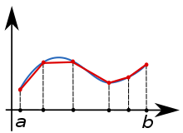
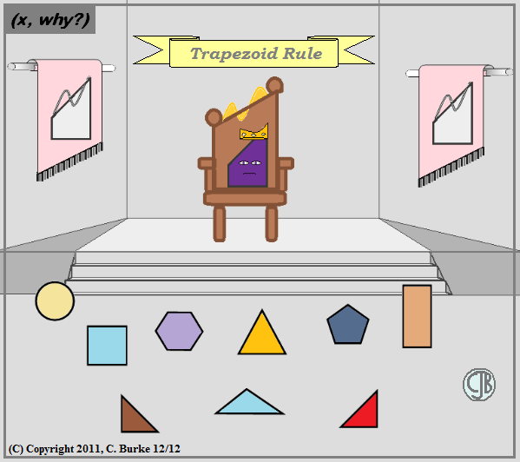

Trapezoidal
Error: O(dt²)
GENERAL INTEGRAL FORM: u^{n+1} = u^{n} + $\int_{tn}^{tn+1}{f\left( t, u\left(t\right) \right) dt}$
u^{n+1} = u^{n} + dt x f*
TRAPEZOIDAL: u^{n+1} = u^{n} + dt/2 [ f(t^{n},u^{n}) + f(t^{n+1},u^{n+1}) ]

Slide 7
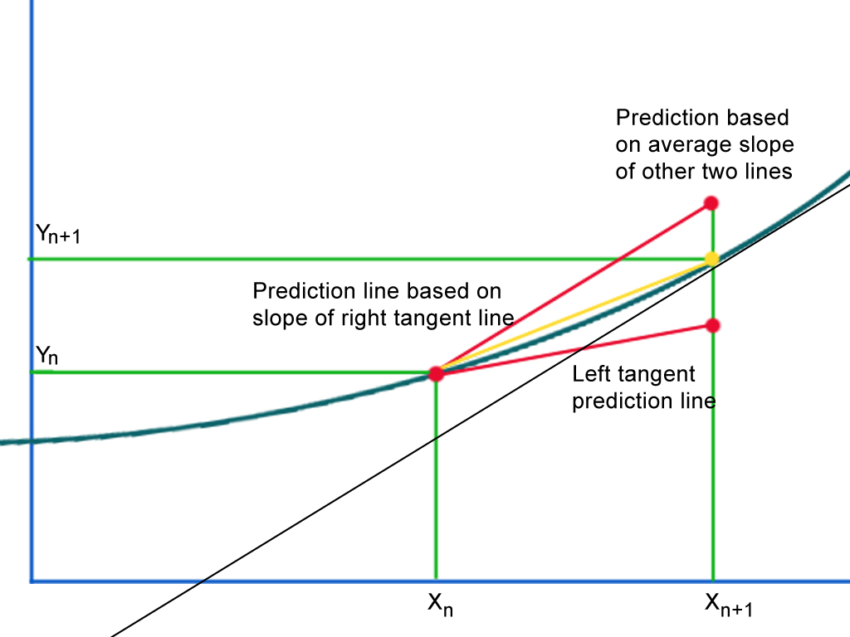

Huen’s (Class: Predictor corrector)
Error: O(dt²)
GENERAL INTEGRAL FORM: u^{n+1} = u^{n} + $\int_{tn}^{tn+1}{f\left( t, u\left(t\right) \right) dt}$
u^{n+1} = u^{n} + dt x f*
HUEN’s: u* = u^{n} + dt x f(t^{n}, u^{n})
u^{n+1} = u^{n} + dt/2 [ f(t^{n},u^{n}) + f(t^{n+1},u*) ]

Slide 8

Runge-kutta (general)
Error: O(dt²)
GENERAL INTEGRAL FORM: u^{n+1} = u^{n} + $\int_{tn}^{tn+1}{f\left( t, u\left(t\right) \right) dt}$
u^{n+1} = u^{n} + dt x f*
RUNGE-KUTTA: u* = u^{n} + a x dt x f(t^{n}, u^{n})
u^{n+1} = u^{n} + dt [ (1- ( ½ a) x f(t^{n}, u^{n}) + ( ½ a) + f(t^{n} + a x dt, u*) ]
When a = 1, you have Huen’s
When a = ½, you have the Midpoint Rule

Slide 9
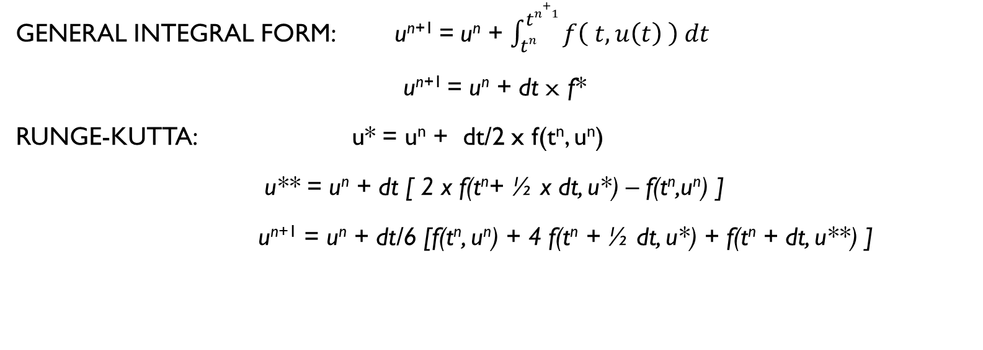
RUNGE-Kutta (3rd Order)
Error: O(dt3)
GENERAL INTEGRAL FORM: u^{n+1} = u^{n} + $\int_{tn}^{tn+1}{f\left( t, u\left(t\right) \right) dt}$
u^{n+1} = u^{n} + dt x f*
RUNGE-KUTTA: u* = u^{n} + dt/2 x f(t^{n}, u^{n})
u** = u^{n} + dt [ 2 x f(t^{n}+ ½ x dt, u*) – f(t^{n},u^{n}) ]
u^{n+1} = u^{n} + dt/6 [f(t^{n}, u^{n}) + 4 f(t^{n} + ½ dt, u*) + f(t^{n} + dt, u**) ]

Slide 10
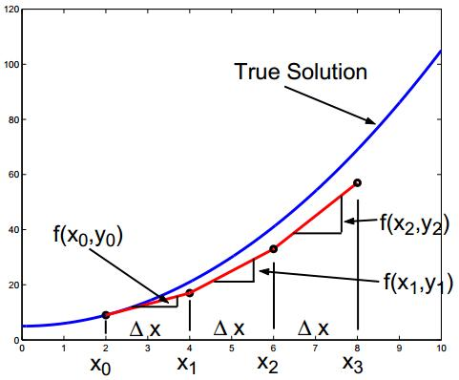
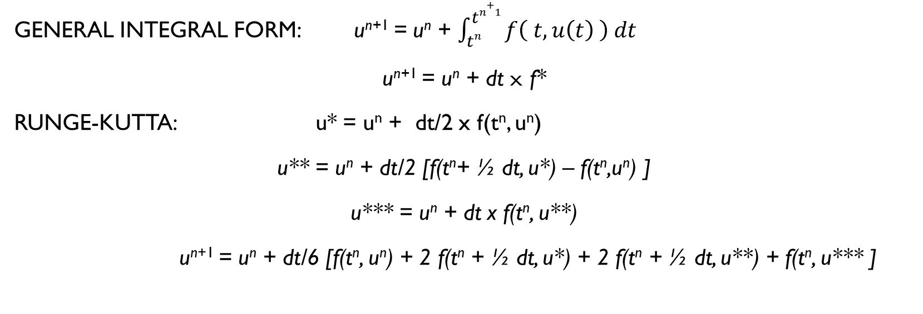
RUNGE-KUTTA (4th Order)
Error: O(dt⁴)
GENERAL INTEGRAL FORM: u^{n+1} = u^{n} + $\int_{tn}^{tn+1}{f\left( t, u\left(t\right) \right) dt}$
u^{n+1} = u^{n} + dt x f*
RUNGE-KUTTA: u* = u^{n} + dt/2 x f(t^{n}, u^{n})
u** = u^{n} + dt/2 [f(t^{n}+ ½ dt, u*) – f(t^{n},u^{n}) ]
u*** = u^{n} + dt x f(t^{n}, u**)
u^{n+1} = u^{n} + dt/6 [f(t^{n}, u^{n}) + 2 f(t^{n} + ½ dt, u*) + 2 f(t^{n} + ½ dt, u**) + f(t^{n}, u*** ]

Slide 11
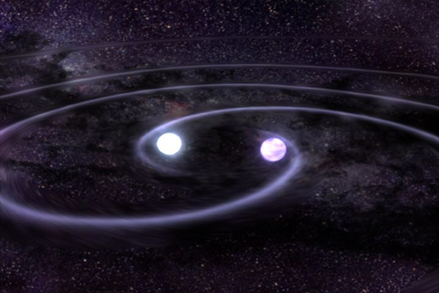
Systems of Ode(s)
Each step is based of the last. Similar to the Gauss Seidel method, each u*
A picture to describe what is going on?
Imagine 2 stars orbiting each other. To determine each one’s position you need data from the other star.
Similarly with systems of ODE whose dependent variables are the same, to find each step, you need information on the other equation’s position. In that way, each step is based on the last.

Slide 12
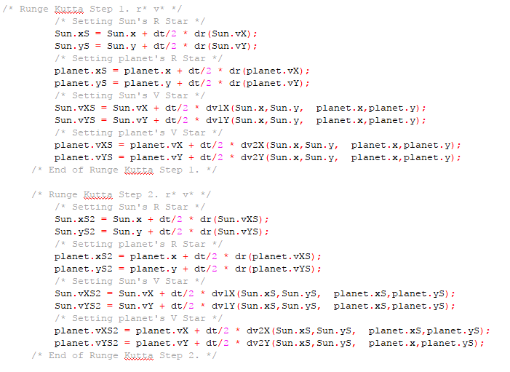
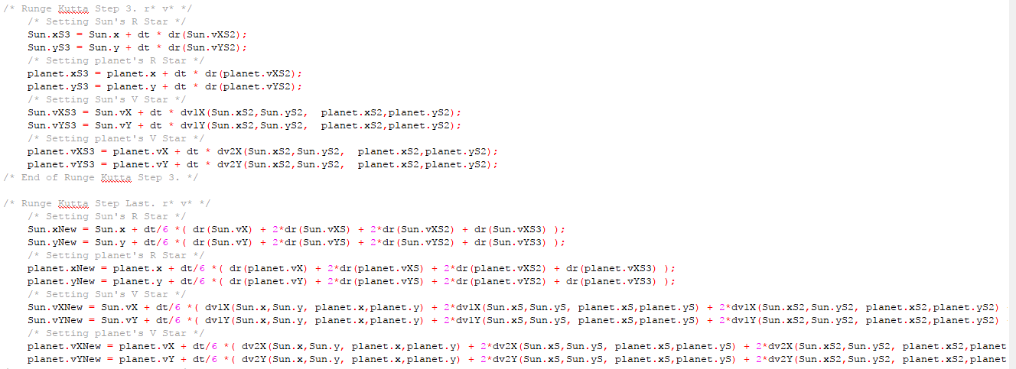
Systems of ode Example

Slide 13
Sources
Dr Prosperreti Notes: Chapter 5 and 6
PICTURES
https://en.wikipedia.org/wiki/Integral
https://centralmathteacher.wikispaces.com/Riemann+Sums%28using+left%2C+right%2C+and+midpoint+evaluation+points%29
http://tutorial.math.lamar.edu/Classes/CalcII/ApproximatingDefIntegrals.aspx
http://mrburkemath.blogspot.com/2011/
https://kr.mathworks.com/matlabcentral/mlc-downloads/downloads/submissions/55830/versions/4/screenshot.JPG
http://chandra.harvard.edu/resources/illustrations/whitedwarfs.html

